Slide 1
What is Travel Trade?

Slide 2
What is OMCA?
We are a not-for-profit membership-based organization that is not funded by the government. Our mandate is to enhance the growth and viability of our group tourism members’ organizations and the safety and quality of industry services through education, awareness and advocacy.

Slide 3
What is Travel Trade?
Travel trade refers to the distribution network for tourism products comprised of tour operators, travel agents, online travel agents, and tourism operators/suppliers.
What is a Tour Operator?
What is the difference between a tour operator and a Travel Agent?
Notes:
What is a Tour Operator?
A tour operator controls, books and creates the whole trip. They curate a vacation package by combining all elements such as hotel, activities, restaurants and tours.
What is the difference between a tour operator and a Travel Agent?
The difference is that the tour operator creates packages and sells them either to the consumer or the travel agent. The travel agent sells a package on behalf of the tour operator, a travel agent will also book components of a package direct ex. Ottawa Highlights package or attraction tickets like Canada's Wonderland. Travel Agents usually sell to Foreign Independent Traveller (FIT) clients.

Slide 4
Types of Operators
Wholesale Tour Operator
Educational Tour Operator
Sightseeing operator
Receptive Tour Operator
On-line travel agent
Tour Operator
Notes:
Wholesale Tour Operator: Creates tours (Both Group and FIT) and sells them to Tour Operators, Receptive Operators and Travel Agencies
Educational Tour Operator: Creates educational trips for students
Receptive Tour Operator: Sells a specific geographical area (ex. North America, Canada, US or city only) direct to a Tour Operator. May target specific markets (like Germany, Asia Pacific, or Mexico)
Sightseeing operator: Sells specific city tours or specialized tours, does not include a full package like accommodations at a specified time. Ex. Food tour, hop on hop off city tour
On-line travel agent: Sell tour operator packages, attractions, hotels, accommodations and/or sightseeing tours on-line only to consumers world-wide.

Slide 5
What is the difference between a tour and an itinerary?
An itinerary is a list of the things you will do on a trip and when you will do them, day by day, hour by hour.
A tour package is what you can be expected to receive for the money you pay a tour operator

Slide 6
Who leads a tour?
A Group Leader
A Tour Guide
A Step-On Guide
Tour Leader/Director
Driver
Notes:
What is Group Leader?
The customer of a tour operator, leader of the group that the tour operator is selling to.
Example: recreational director of a senior group; a teacher; a coach; a church leader; Boy scouts' leader or girl scouts
What is a Tour Guide?
The person who leads the tour with commentary, education and expertise.
What is a Step-On Guide?
A person who gets onto the coach in a specific area for a specific amount of time. Provides expertise and education to enhance the tour.
What is a Tour Leader/Director?
Works for the tour company and is responsible to ensuring a successful itinerary for the clients.

Slide 7
Types of tours :
Day trips
Multi-day trips
Hub and Spoke itineraries
Sightseeing/excursions
Notes:
Day trips: no accommodations
Multi-day trips: same city, multiple cities, or multiple countries – Overnight tours, need to be TICO registered
Sightseeing/excursions: specific area, special interest, city, hop on/off
Hub and Spoke itineraries: Stay in one area but tour out to other cities and/or experiences
Special Interest tours: specific tours with a common interest; such as architecture, history, grandparent/grandchildren, cultural tours, food tours, cooking tours

Slide 8
Who are the clients?
Retail group tours
Pre-formed group
Special interest groups
SMERF groups
Notes:
Retail group tours: consumers who don’t know each other buy a specific tour and go together as a group
Pre-formed group: everyone in the group knows each other or is part of the same group ex. Church group or school group
Special interest groups: Groups may or may not know each other but share a common interest. Example: bird tours, architecture tours, and history tours.
SMERF groups: Social, Military, Educational, Religious and Fraternal (ie. sports groups, women’s tours, air cadets, membership-based, bachelor parties, bachelorette parties etc.)

Slide 9
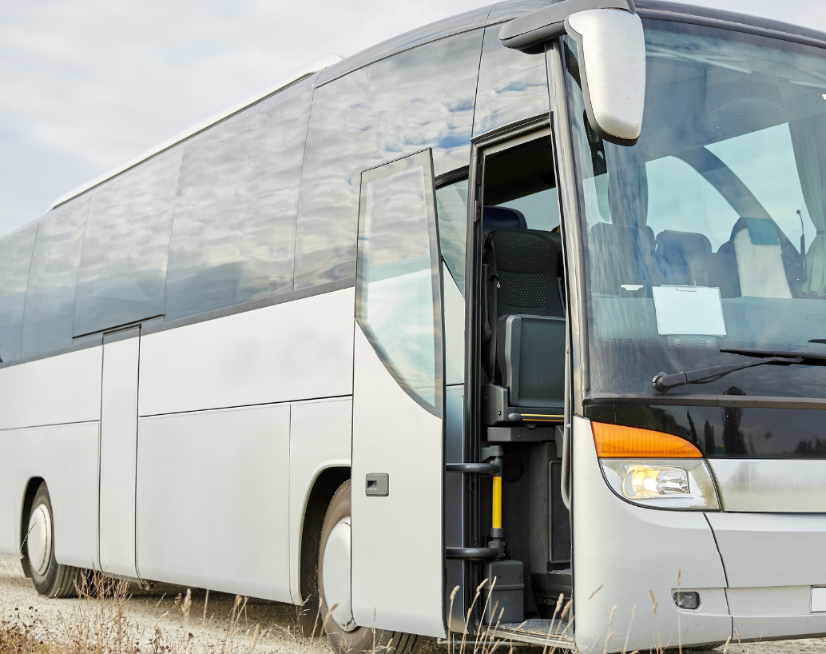
What is a Bus Operator or Motor Coach Carrier?
Bus operators/motor coach carriers are private companies that own motor coaches and/or other passenger vehicles and perform a variety of transportation services, such as:
Charters
Scheduled bus services
Shuttle buses
Line runs
School Buses
Sightseeing
Notes:
What is a Bus Operator/Motorcoach Carrier?
Bus operators/motor coach carriers are private companies that own motor coaches and/or other passenger vehicles and perform a variety of transportation services such as charters, retail tours, scheduled service, sightseeing, local receptive operations, school bus, package express, and special operations.
Charters: renting a bus
Scheduled bus services: City to city, country to country, intercity transportation: scheduled a specific times to go to specific places
Shuttle busses: take you from one area to another: example: hotel to airport, hotel to convention centre, continuously runs back and forth between locations for a specific time
Line runs: Does a specific transportation line run: intercity transportation, taking someone from one location to another at a specific time and does pick ups along the way.
School Bus Operator: takes kids to schools or on school trips
Sightseeing operators: runs specific tours through the day

Slide 10
Suppliers
What is a Tourism Supplier?
What are Products and Services Organizations?
Notes:
What is a Tourism Supplier?
Any organization that is an accommodation, attraction, food service provider, destination marketing organization, retailer or tour service provider. Tour service and Local Receptive Operators also fall into this Tourism Supplier Membership category.
What are Products and Services Organizations?
Products & Services suppliers include companies that provide products and/or services to tour or motorcoach operators. Examples include: Insurance, Marketing & Communications, Online Travel-Booking/Internet Service, Promotional Products, Ticket Company, Security Service-Equipment, Consultant, Drug/Alcohol Screening, Legal Service, Maintenance & Repair, Bus Refurbishing/Remanufacturing/Upholsterer, Seating Manufacturer, Tires, Uniforms, Oil & Gas Company, Fuel, Brakes, Bus Dealer, Bus Part Distributor, Chemicals, Computer Hardware, Computer Software, Electronics, Engines, Fleet Graphics & Vehicle Wraps, Glass/Mirrors/Windows, Paint, etc.

Slide 11
How do you track Return on Investment (ROI)
3 years to gain full business potential
Compare ROI on different mediums
Excel spreadsheet with appointments
Track annually for 3 years
Notes:
3 years to gain full business potential
Compare ROI on different mediums
Excel spreadsheet with appointments
Track annually for 3 years

Slide 12
What does Travel Trade mean to your business?
Expertise
Value​
Sales
Notes:
Your product is organized by an expert
You only deal with one person (but gain the finances of a large group)
The Business comes all year round
This market books far in advance, can help with forecasting
This market can help fill your off-season
You can target this market to come to specific events, new itineraries etc.
They pay in advance
They are in and out of your property all at once and they leave a lot of money behind
Gentle on the property
This is a very loyal market

Slide 13
What does Travel Trade mean to your Destination?
Average spend per person:
$721.55 for bus travel
$514.96 by car
$1,017.31 arriving by air
For a destination, assuming a motor coach has 52 travelers, this means that the economic value is approximately $37,500 per bus per night
Notes:
OMCA has been using the TSA and integrating its data with various sources, such as the Visitor Travel Survey and available data that captures planned visitations into destinations to better help assess the economic significance of the group travel market to tourism. With this data, we can determine that the indirect contribution to destinations and local economies is significant yet often unstated. For example, Statistics Canada’s Visitor Travel Survey shows an average overnight spend per person of $721.55 for bus travel. This is compared to $514.96 for those traveling by car and $1017.31 for those arriving by air. For a destination, this means assuming a motor coach has 52 guests traveling on it. The economic value is approximately $37,500 per visitor night. It also means that a destination investing in group travel will reduce its traffic and parking congestion and increase its economic benefits.

Slide 14
How do Tour Operators do business?
They are in the business to sell vacations, a good time, fun and memories!
Direct sell
Selling cycle is 1 – 2 years ahead
How do they sell?
Notes:
They are in the business to sell vacations, a good time, fun and memories!
They sell direct to consumers, Travel agents, group leaders, or special interest groups.
Their selling cycle is 1 – 2 years ahead (the farther away the client the longer the selling cycle).
How do they sell?
Brochures
Websites
Advertising
Tariffs

Slide 15
What Do Tour Operators Need to Sell Your Products?
A Contact person
Rates
Tier pricing
FAM tour/Site inspection
Service Description
Images
Notes:
A regular contact in your organization.
Rates a year in advance
Tier pricing
Retail rates: what you sell to consumer direct
Group rates: what you sell direct to a group, usually 10% off retail
Tour Operator rates: usually 20% off retail rates
Wholesale/Receptive Rates: usually 30% off retail
FAM tour/Site inspection (in person or virtually) so they get to know your product
Description of your property/service so they can easily explain it to the clients
Images that visually sell your product
For brochures, websites, itineraries

Slide 16
How do you attract this market to your property?
Notes:
Infrastructure needed
Make sure a bus can get to your property and the infrastructure is in place for a bus to get in and out, make turns
Offer free bus parking, if applicable
Offer amenities for drivers (washrooms, microwave, bus cleaning services)
Make sure your property is accessible and can accommodate a large amount of people at one time
If available have a separate group entrance, separate or designated eating area, or location for group

Slide 17
Sales 101
Lead Generation
Sales Materials
Notes:
Lead Generation
Follow up on Leads (Destination, Marketplace, General, Emails) in a timely manner, because if you don’t someone else will
Sales Materials
Brochures
Profile Sheets
Videos
Images
Website (dedicated to travel trade or page dedicated to travel trade)
YOU (sell, network and build relationships)

Slide 18
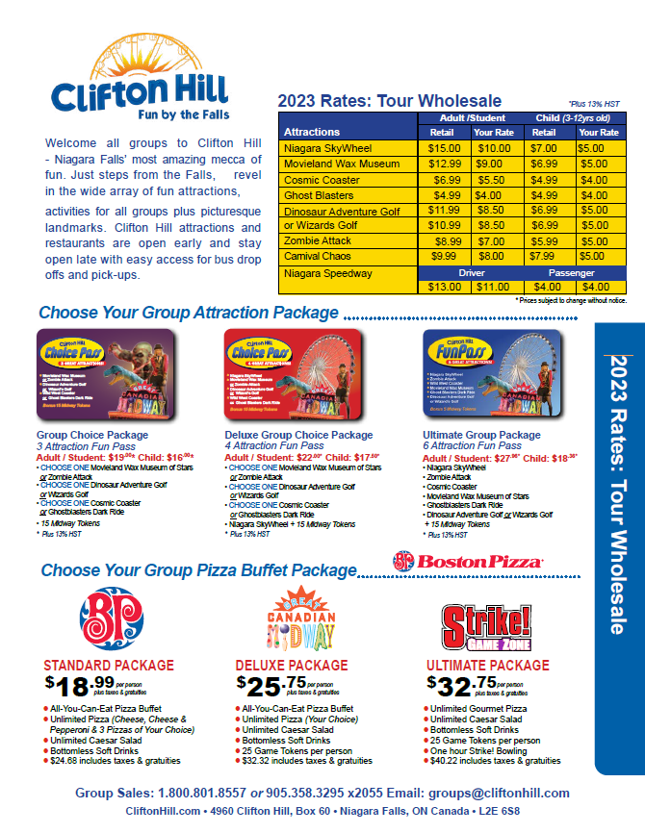
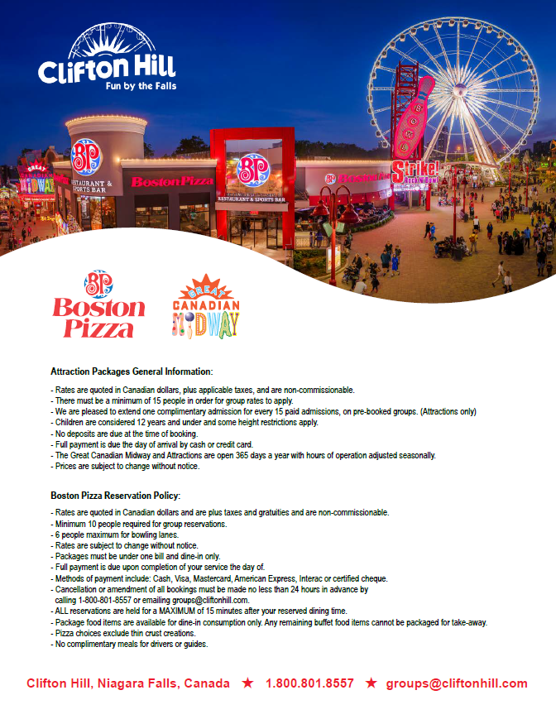
What are Profile Sheets?
A 1-page front and back
flyer (advertising piece)
that sells your property.
Notes:
A 1-page front and back flyer (advertising piece) that sells your property.
It contains:
Contact information, location, logo, address
Description of your property and services
Map to your location (how are from major cities if applicable)
Images to visually sell your product
Suggested sights along the way or things to do while they are there (give them more reasons to come to your property/service)
Climate (if needed)

Slide 19
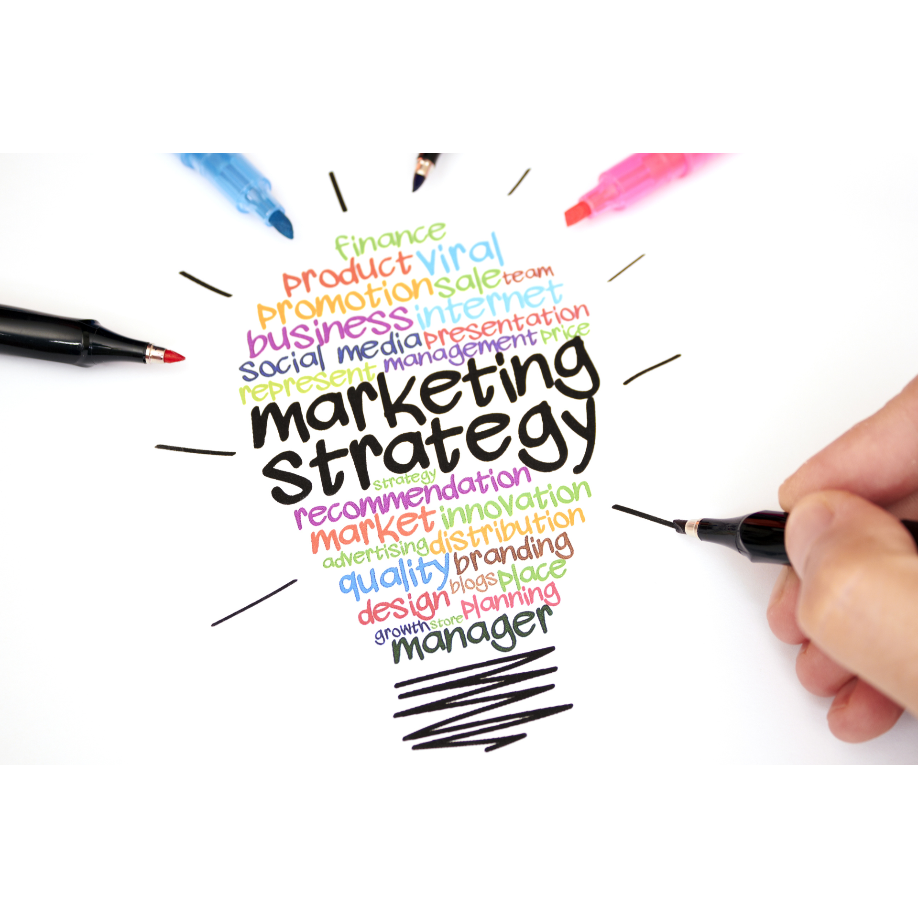
Marketing 101
Targeted Marketing
Emails
Advertising
Social Media
FAM Tours
Sales Calls
Newsletters
Join Associations
Attend Marketplaces
Attend Industry Events
Notes:
Targeted Marketing
Emails
Advertising
Social Media
FAM Tours
Sales Calls
Newsletters
Join Associations
Attend Marketplaces
Attend Industry Events

Slide 20
What is a FAM tour? The best way to sell your product is for the client to experience it.
A Familiarization Tour (FAM tour) is a complimentary site/tour of your property for the purpose of securing the client to buy your services by having them get to know and become familiar with it.
Tour Operator Driven
DMO created
Organized by you
Notes:
A Familiarization Tour (FAM tour) is a complimentary site/tour of your property for the purpose of securing the client to buy your services by having them get to know and become familiar with it.
You can organize your own FAM tour and bring clients to you to showcase your products
A Tour Operator can organize their own FAM tour and bring their clients to your property?
A DMO (Destination) can organize a FAM tour and bring the clients to your property.

Slide 21
How do I network?
Start a Conversation
name tag
business cards
Location/Visibility
Colleague Introductions
Active Engagement
Elevator pitch
Welcoming statue
Notes:
Prepare Conversation starters
Wear a name tag or badge
Bring business cards
Stand in an area where people will naturally talk to you (a bar)(doorway)
Ask your DMO to introduce you to people
Use Active listening, ask questions, engage the client
Elevator pitch ready (10s, 20s, 60s)
Welcoming statue: stance, smile, eye contact

Slide 22
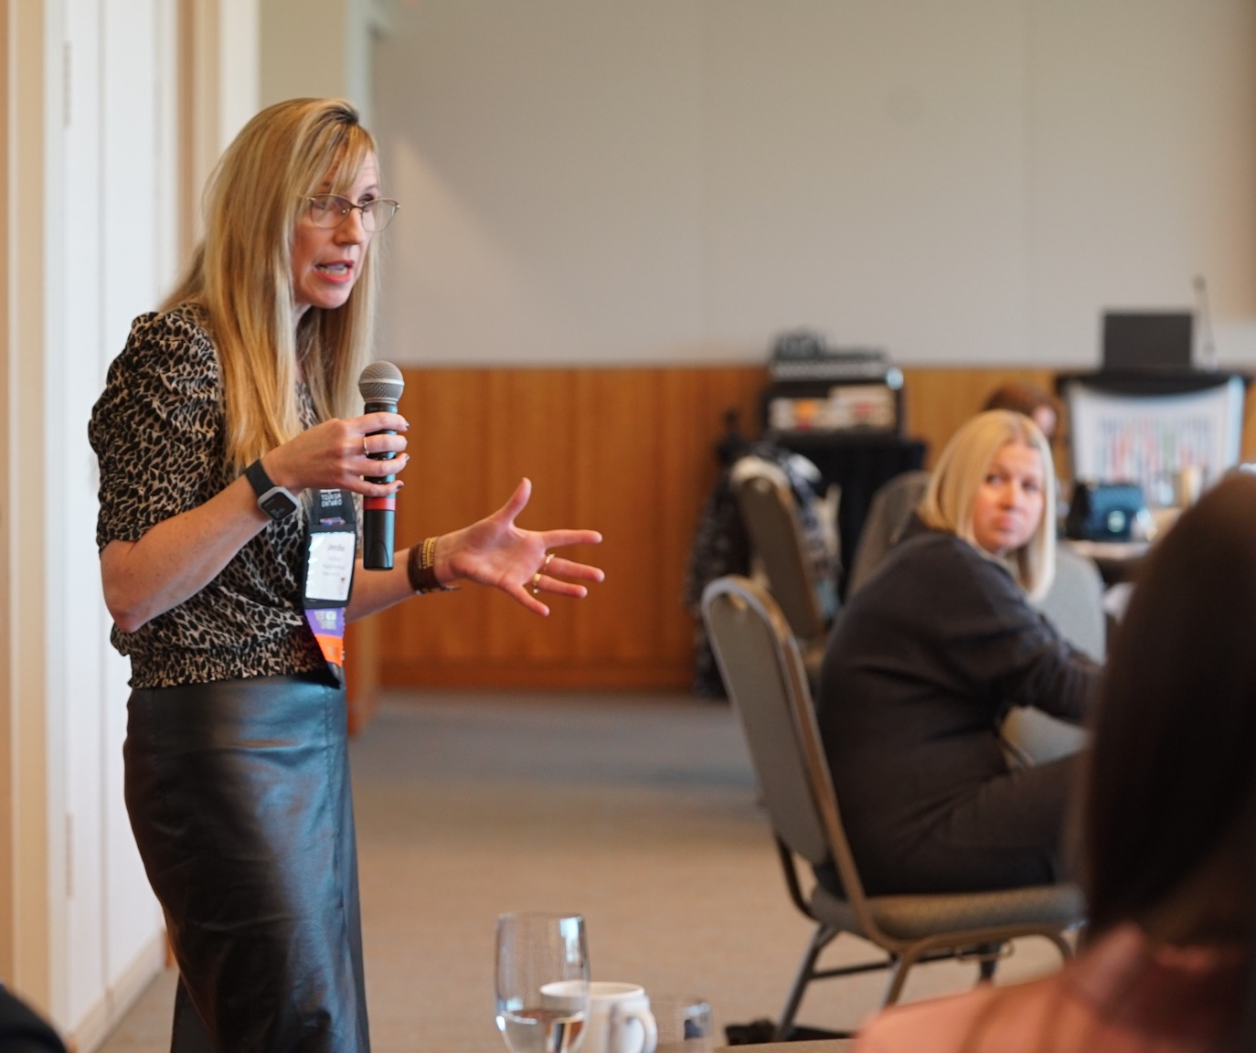
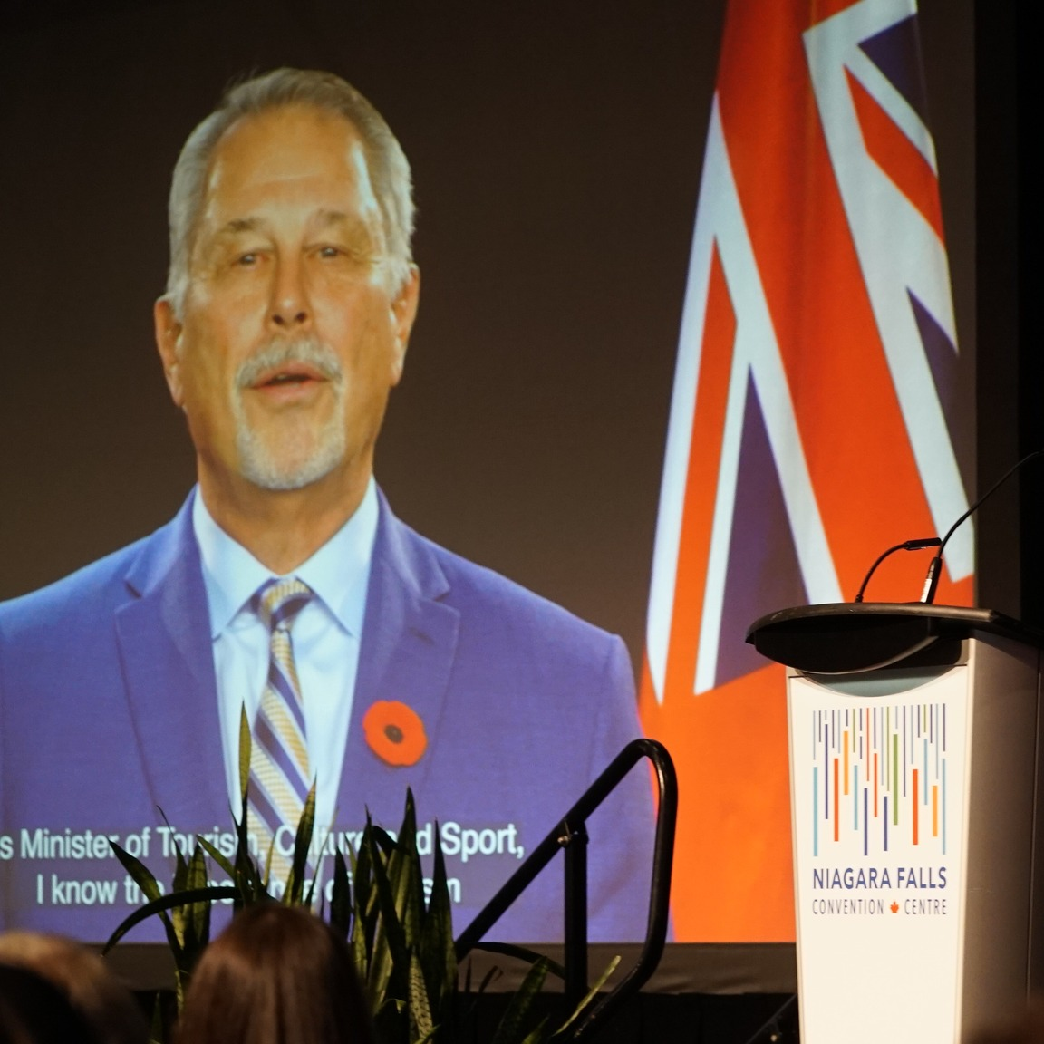
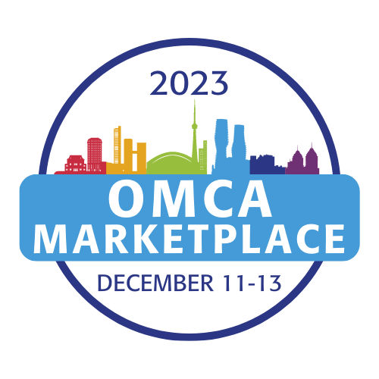
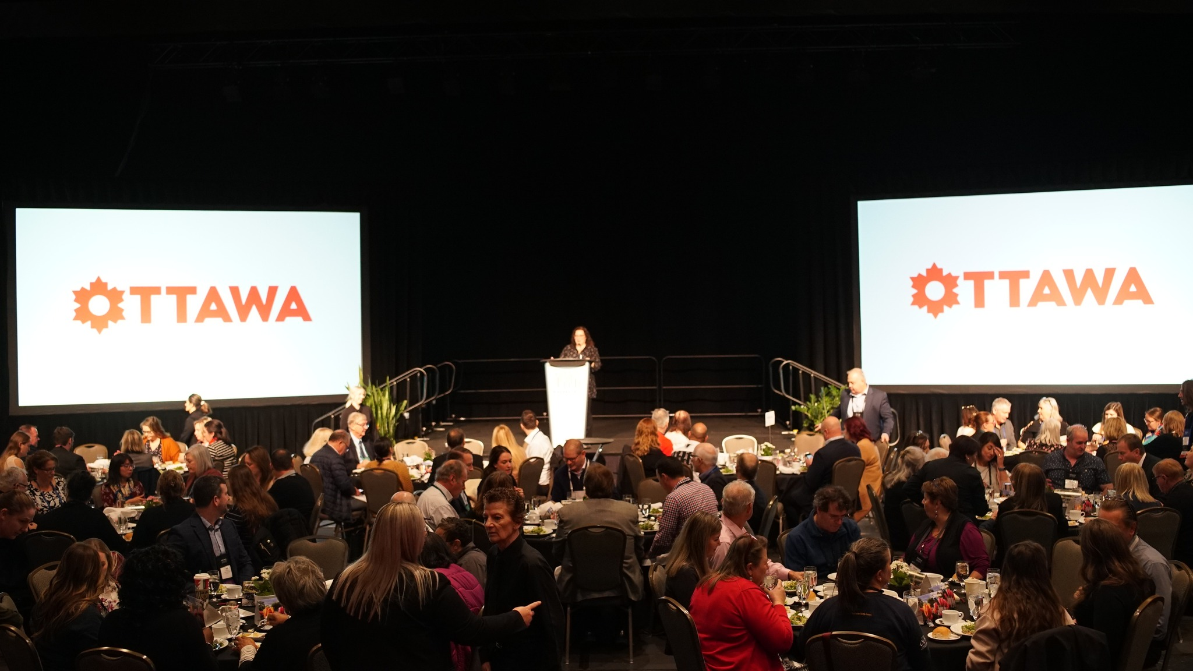
What is the OMCA Marketplace?
The premier marketplace in Canada
2 days of one-on-one B2B appointments
Networking events
Education Speakers on relevant topics

Slide 23
How do you budget for this market?
Allow for tier pricing
1
Join associations, contact membership@omca.com and we can help connect you
2
Attend Marketplaces that provide the best ROI for your needs.
3
Notes:
Allow for tier pricing
Join associations, contact membership@omca.com and we can help connect you to the right association that works for your needs.
Attend Marketplaces that provide the best ROI for your needs.

Slide 24
How do you train your staff on the importance of this market?
Use this presentation to train your staff, it will live on the OMCA website www.omca.com
Use the membership tool kit available for members only to train your staff
Contact membership@omca.com and we can help connect you to what you need

Slide 25
OMCA Member Tool Kit
Travel Trade Handbook
Successful Networking flyer
Tourism Acronyms
How to make a profile sheet?
Sample profile sheets
More to come
Marketplace Preparation checklist
How to create a successful FAM tour
Notes:
Travel Trade Handbook
How to do network successfully?
Tourism Acronyms and phrases
Prepare of a marketplace?
Marketplace checklist
How to do a FAM tour?
FAM tour checklist
How to make a profile sheet
Sample OMCA profile sheet
DMO profile sheet
Attraction/Restaurant profile sheet

Slide 26
Be in the know: Receive updates and know what is happening in the industry
DMO Memberships
Associations Memberships
Tourism/Advocacy Networks
Newsletters:
https://omca.com/news-publications/newsletters/
Notes:
DMO: Join your local DMO
Let them help guide you
Destination Ontario
Destination Canada
Associations
Join associations, like OMCA, they make attracting the market so much easier
Sign up for OMCA's Newsletter (link to newsletter)
Tourism/Advocacy Networks
If you need it, join tourism/advocacy networks, like here in Ontario TIO or TIAC and OMCA can assist with that as well
Sign up for newsletters

Slide 27
Questions?

Slide 28
Thank you!
Benefits of membership:
Group Sales Directory
Access to database
Advocacy
Networking
Marketplace
Expertise
Community
Not a member, join today! https://omca.com/join-omca/
Notes:
Thank you for taking the time to be part of this presentation, we are #bettertogether and will make this industry stronger together.
Thank to all our members your dedication to growing this market and trusting in OMCA to help you.

